Slide 1
MongodB Assignment
Group 13
Jianzhou Liu

Slide 2
Objectives
1. Group Presentation: 9 Best MongoDB GUI Tools
2. Write stored procedures to extract and save JASON files from Instacart fact table(denormalized).
3. Build a MongoDB database called Instacart and upload the JASON file.

Slide 3
Presentation: 9 Best MongoDB GUI Tools
As from the introduction of the MongoDB tutorial, there are many MongoDB management tools available in the market. Here is the list of the 9 best MongoDB GUI tools in 2019:
1.NoSQLBooster 6.NoSQL Manager
2.Studio3T 7.Mongo Management Studio
3.Robo3T 8.MongoJS Query Analyzer
4.MongoDB Compass 9.Cluster Control
5.Nucleon Database

Slide 4

1.1 NoSQLBooster
Features:
Build-in language service knows all possible completions, methods, properties, variables, key words, even the MongoDB collection names, field names and operators.
Run SQL SELECT Query against MongoDB. SQL support includes functions, expressions, aggregation for collections with nested objects and arrays.
Assemble npm packages like building blocks in your MongoDB shell script.
Translate MongoDB queries (find, aggregate or SQL query) to various target languages: MongoDB Shell, JavaScript (Node.js), Java, C# and Python.
Visual query builder tp create statements even without the knowledge of the MongoDB shell commands syntax.
Notes:
Npm is a package manager for the javascript programming language

Slide 5
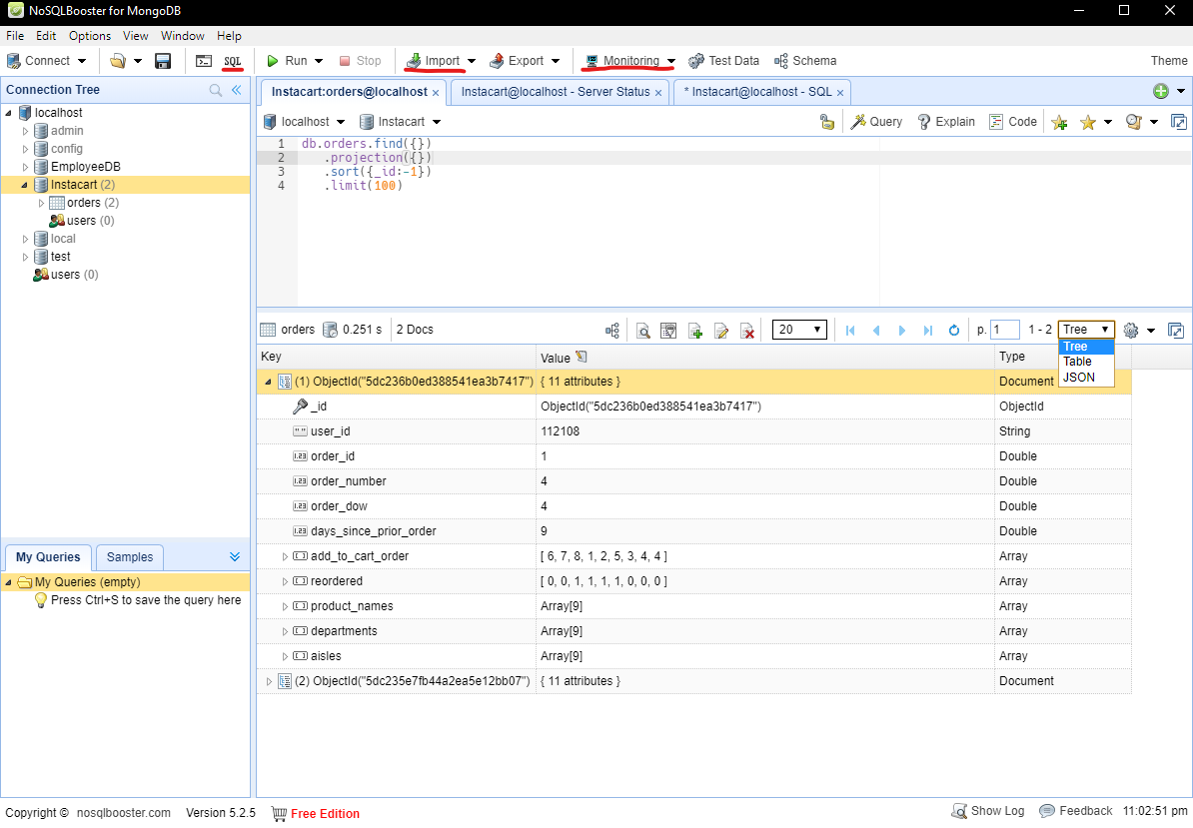
1.1 NoSQLBooster
Fast response speed once you update your database
Many powerful functions such as importing JSON/BSON files, tables from MySQL server, monitoring the server status, etc

Slide 6

1.2 Studio3T
Features:
Autocomplete queries with IntelliShell
Drag and drop fields to visually build queries
Use SQL, with INNER and OUTER joins, to query MongoDB
Generate driver-code from SQL or mongo shell into PHP, Python, Javascript and others
Secure connections for single MongoDB instances and replica sets
Copy and paste documents across servers and databases
Effortlessly compare and synchronise data
Build aggregation queries stage by stage
Multiple ways to import & export, including SQL Migration
Automate and schedule repetitive MongoDB tasks like imports

Slide 7
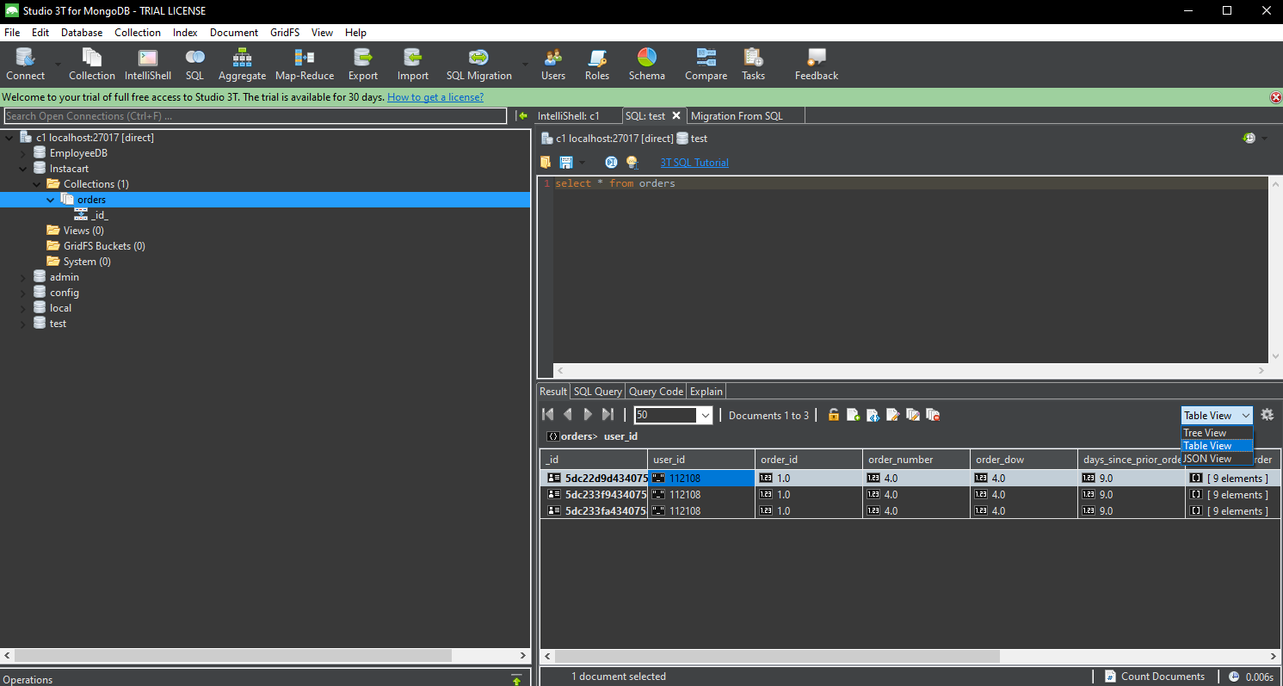
1.2 Studio3T
Very fast response speed
powerful functions
can explore data visually or by shell
Like a enhanced version of NoSQL Booster.

Slide 8

1.3 Robo3T
Robo 3T is the popular free GUI for MongoDB enthusiasts. This lightweight, open-source tool has cross-platform support and also embeds the mongo shell within its interface to provide both shell and GUI-based interaction. It is developed by 3T Software, the team behind Studio 3T, the IDE for MongoDB.
Features:
Embedded shell environment
Asynchronous non-blocking UI
Supports MongoDB 4.0

Slide 9
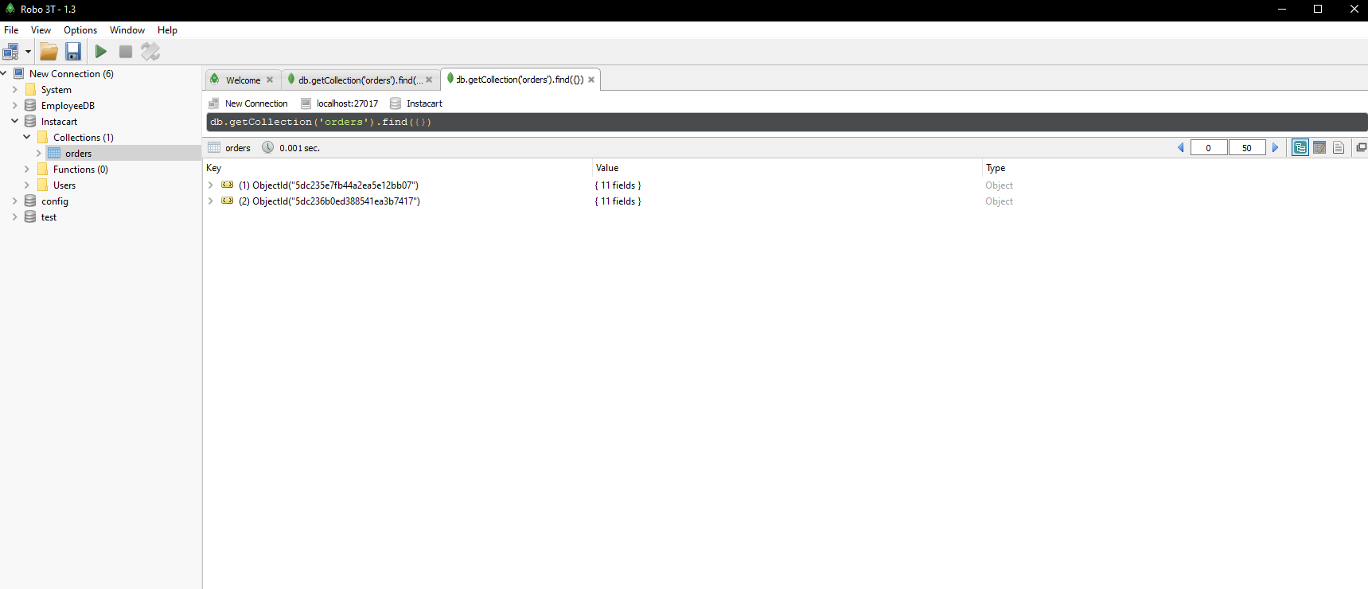
1.3 Robo3T
Fastest response speed
simplified functions

Slide 10
1.4 MongoDB Compass
Features:
The tool allows to explore data visually
MongoDB Compass analyzes documents and displays rich structures within one collection using Run ad-hoc queries in seconds
Supports quick insight into server status and query performance
Allows to view query performance
A better approach to CRUD makes it easier to interact
It helps users to take decisions about indexing, document validation, and more
No need to write command line

Slide 11
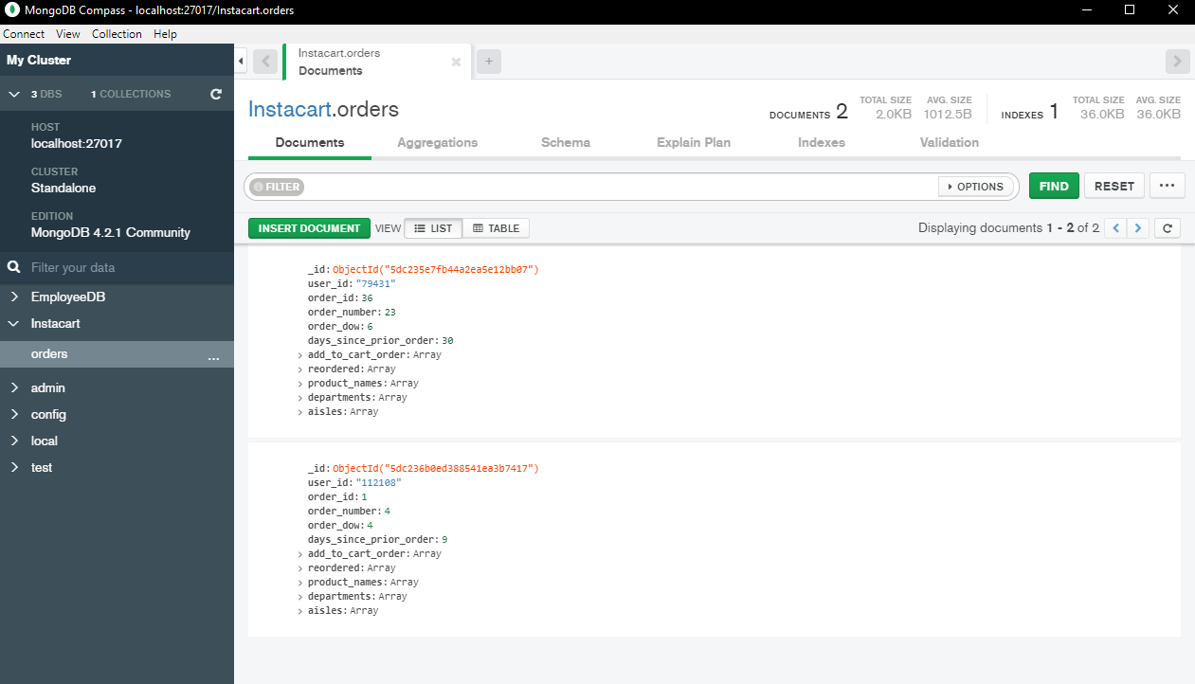
1.4 MongoDB Compass
explore data visually
very slow response speed

Slide 12

1.5 Nucleon Database Master
Features:
Support for JSON/LINQ/SQL Query Editor
It offers powerful and intuitive SQL, LINQ and JSON query editor
The tool provides notable features like code highlighting, code completion and text find and replace
The users can export data into file formats like XML, HTML, MS Office, CSV, OpenOffice, RTF, PDF, XPS, JSON, dBase, and PNG
It provides dynamic C# Scripting query editor which supports Linq to MongoDB and Linq to Dataset
It allows importing data from XML, CSV, and SQL Script files without any size limit.

Slide 13

1.6 NoSQL Manager
Features:
Fully featured MongoDB GUI Shell with code autocompletion, and syntax highlighting
It offers support for replica sets, standalone hosts and sharded clusters connections
Editor comes with three views Tree, Table, and JSON view modes
Easy-to-use document viewer
File Manager Tool to work with GridFS
Simple view and management option for all types of MongoDB objects
Import tables from MySQL and SQL Server databases
Multiple Mongo host database connections
Export documents to CSV, XML, XLSX, and JSON file formats

Slide 14
1.7 Mongo Management Studio
Features:
Mongo Management Studio is cross-platform, so it runs on all major systems
It offers support for MongoDB 3.0 / 3.2 / 3.4
The app allows connecting to remote MongoDB databases using an SSH tunnel
With Mongo Management Studio, it is possible to read and write to GridFS collections
It offers a complete documentation of all features by explaining MongoDB related topics
With its inline edit feature, it is possible to do data manipulation on the fly

Slide 15

1.8 MongoJS Query Analyzer
Features:
The JavaScript statements and queries run within a MongoDB shell command line interface. It can also be typed and executed
The MongoJS Query Analyzer allows users to view the results in a tree hierarchy, grid and as a text result
The MongoJS Pretty Print JSON feature allows displaying the JSON result in an easy to read format
It displays query results in several ways; as text, text history, grid, and pivot grid.
The contents of the Query Analyzer can be saved in different ways and formats

Slide 16
1.9 Cluster Control
Features:
The tool allows users to customize solutions for their own MongoDB deployments
Easily add and remove nodes, resize instances, and clone production clusters with the help of this tool
It provides single interface to automate mixed MongoDB and MySQL database environments
It provides management features that repair and recover broken nodes, and test and automate upgrades

Slide 17
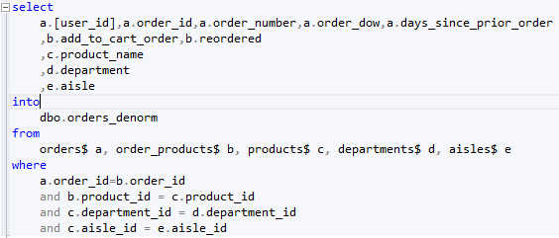
2. JASON files from Instacart table
Mainly use the sample from the professor’s code. But before use that , we need to create the orders_denorm table

Slide 18
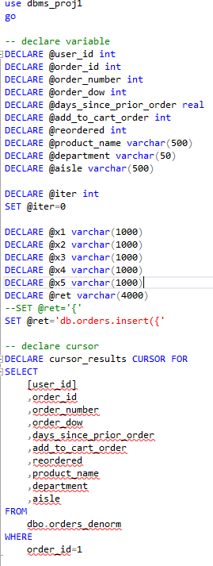
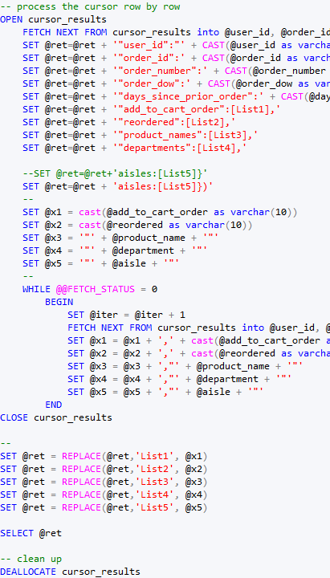

Slide 19



3. Build a MongoDB database called Instacart and upload the JASON file.
Create Instacart database:
Use JASON generated by code:
1. Upload with mongoimport
2. Execute in mongo.exe

Slide 20
